Slide 1
Introduction to Cloud Computing and AWS

Slide 2
Agenda
What is Cloud Computing?
AWS fundamental

Slide 3
1. What is Cloud computing
Subtitle

Slide 4
Characteristics
On-demand self-service
Broad network access
Resource pooling
Rapid elasticity
Measured service
Notes:
References: https://nvlpubs.nist.gov/nistpubs/legacy/sp/nistspecialpublication800-145.pdf
On-demand self-service : provision computing capabilities as needed automatically without requiring human interaction with each service provider (provision and terminate using the UI/CLI without human interaction) Broad network access: Capabilities are available over the network and accessed through standard mechanisms (access services over any networks, on any devices, using standard protocols and method) Resource pooling : there is a sense of location independence … no control or knowledge over the exact location of the resources; resources are pooled to serve multiple consumers using a multi-tenant model. (economies of scale, cheaper service)
Rapid elasticity : Capabilities can be elastically provisioned and released to scale rapidly outward and inward commensurate with demand; To the consumer, the capabilities available appear to be unlimited (scale up and down automatically in response to system load) Measured service : resource usage can be monitored, controlled, reported, … and billed. (usage is measured. Pay for what you consume)

Slide 5
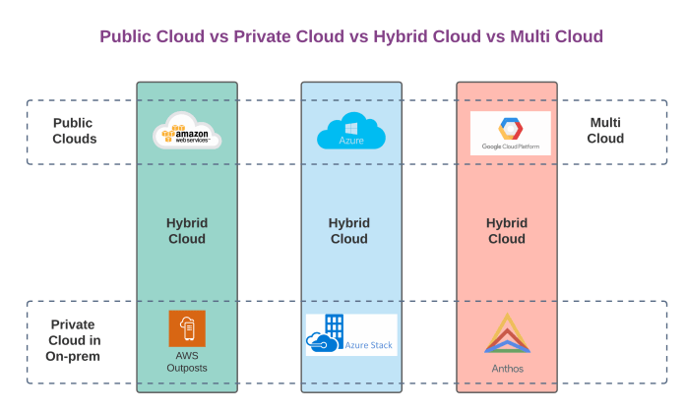
Deployment model
Notes:
Private cloud. The cloud infrastructure is provisioned for exclusive use by a single organization comprising multiple consumers
Public cloud. The cloud infrastructure is provisioned for open use by the general public Hybrid cloud. The cloud infrastructure is a composition of two or more distinct cloud infrastructures (private, community, or public) that remain unique entities Multi cloud: more than one public cloud (not official)

Slide 6
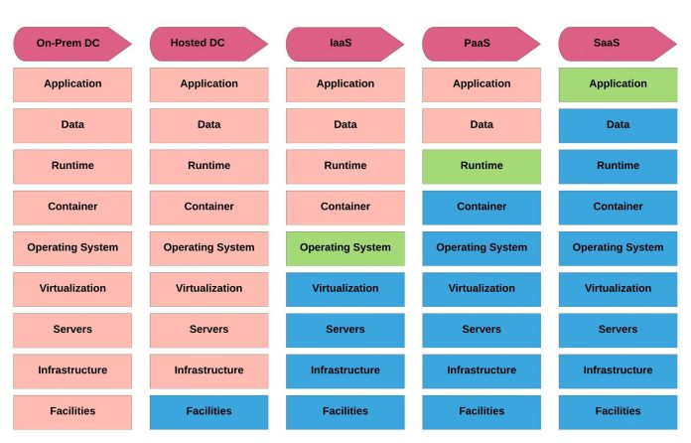
Service Models
Notes:
Infrastructure stack; parts you manage; parts managed by the vendor

Slide 7
AWS fundamental

Slide 8
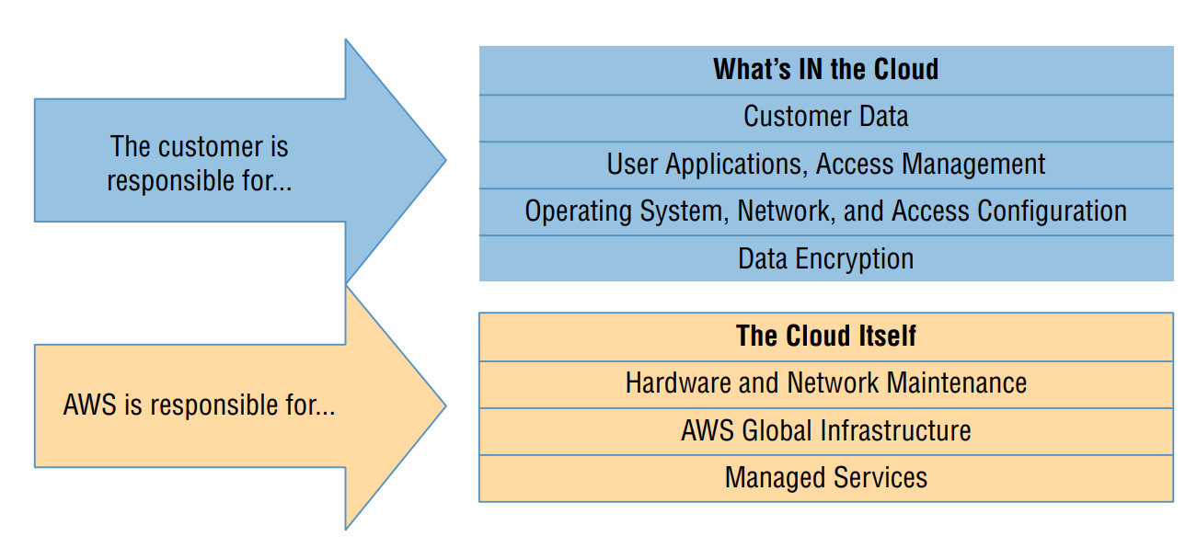
The AWS Shared Responsibility Model
Notes:
AWS guarantees the secure and uninterrupted operation of its “cloud.” That means its physical servers, storage devices, networking infrastructure, and managed services. AWS customers are responsible for whatever happens within that cloud. This covers the security and operation of installed operating systems, client-side data, the movement of data across networks, end-user authentication and access, and customer data.
precisely defining the “cloud”—meaning, what AWS is responsible for—will depend on the particular cloud model you’re using. Ex: EC2 – Iaas, Elastic Beanstalk - PaaS

Slide 9
AWS global infrastructure
AWS Regions
AWS Availability Zones
AWS Data Centers
AWS Edge Locations / Points of Presence
105 Availability Zones within 33 geographic regions, 600+ CloudFront POPs

Slide 10
AWS service categories
Compute: Services replicating the traditional role of local physical servers for the cloud
Networking: Application connectivity, access control, and enhanced remote connections
Storage
Database
Application
Management
Security and identity
Notes:
Compute : Services replicating the traditional role of local physical servers for the cloud, offering advanced configurations such as autoscaling, load balancing, containers, and even serverless architectures Networking :
Storage Database: Managed data solutions for use cases requiring multiple data formats: relational, NoSQL, or caching Application management : Monitoring, auditing, and configuring AWS account services and running resources Security and identity: Services for managing authentication and authorization, data and connection encryption, and integration with third-party authentication management systems

Slide 11
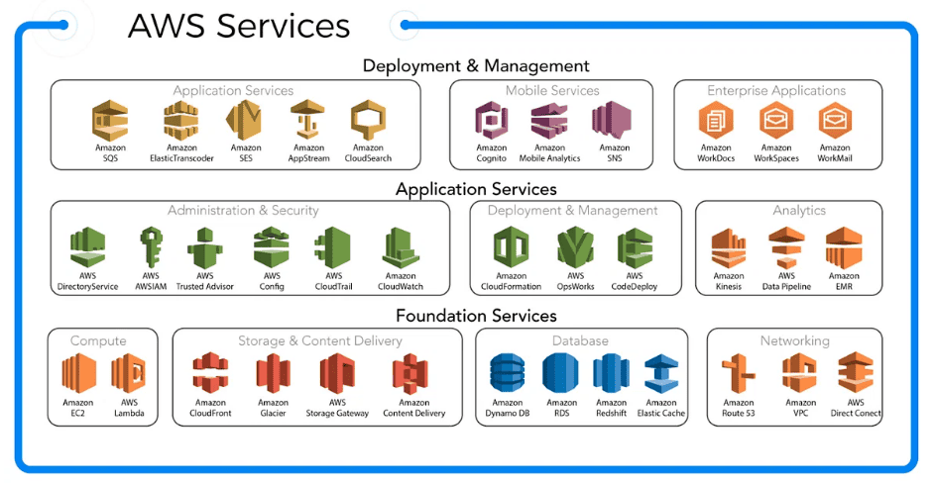
AWS service categories

Slide 12
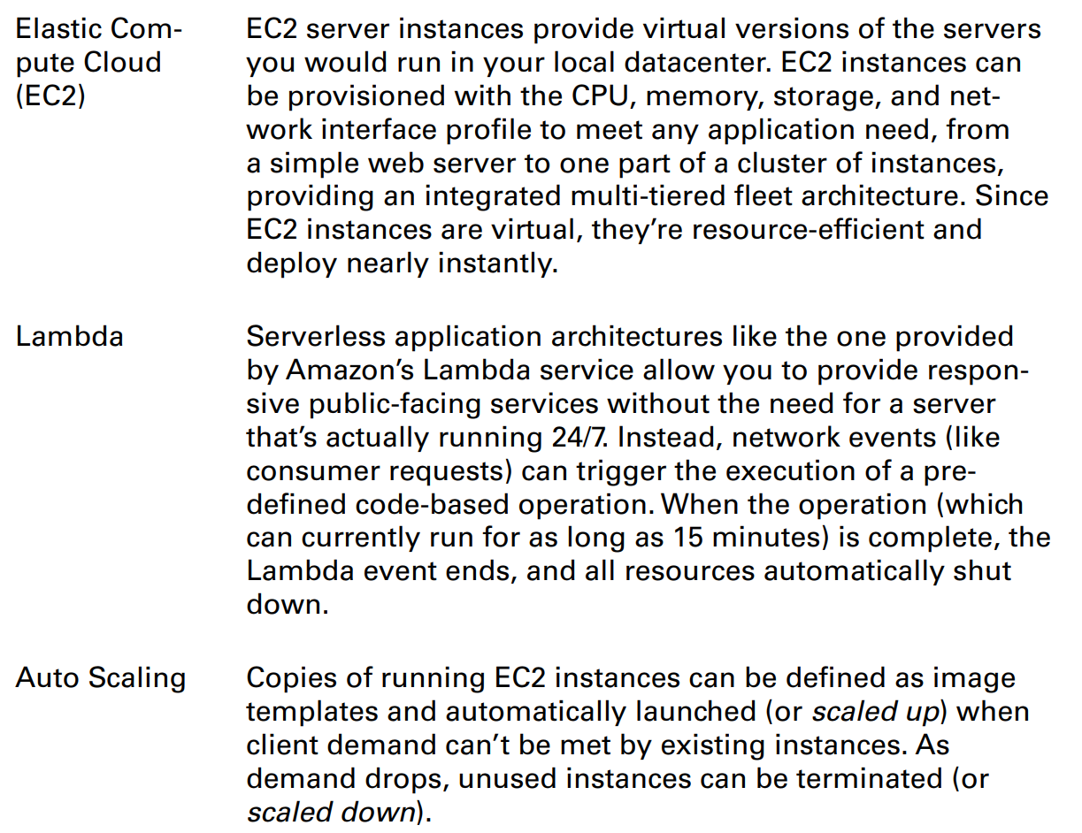
Compute

Slide 13
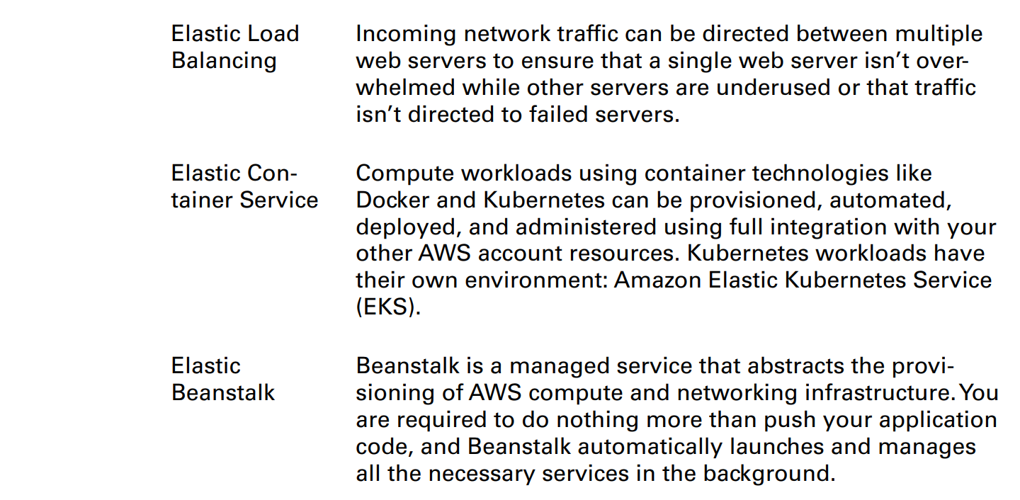
Compute

Slide 14
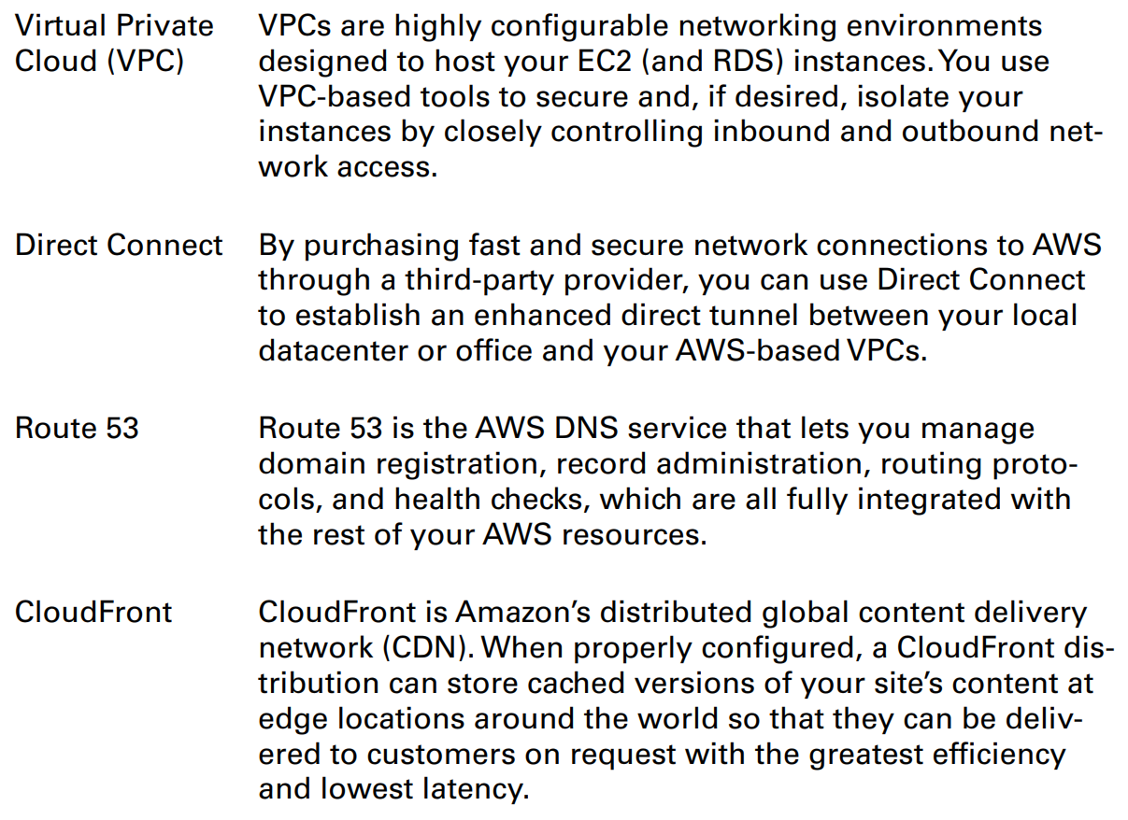
Networking

Slide 15
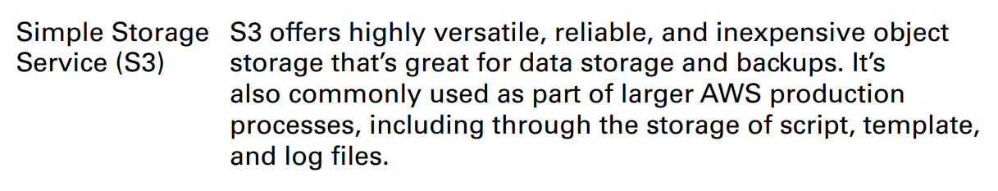
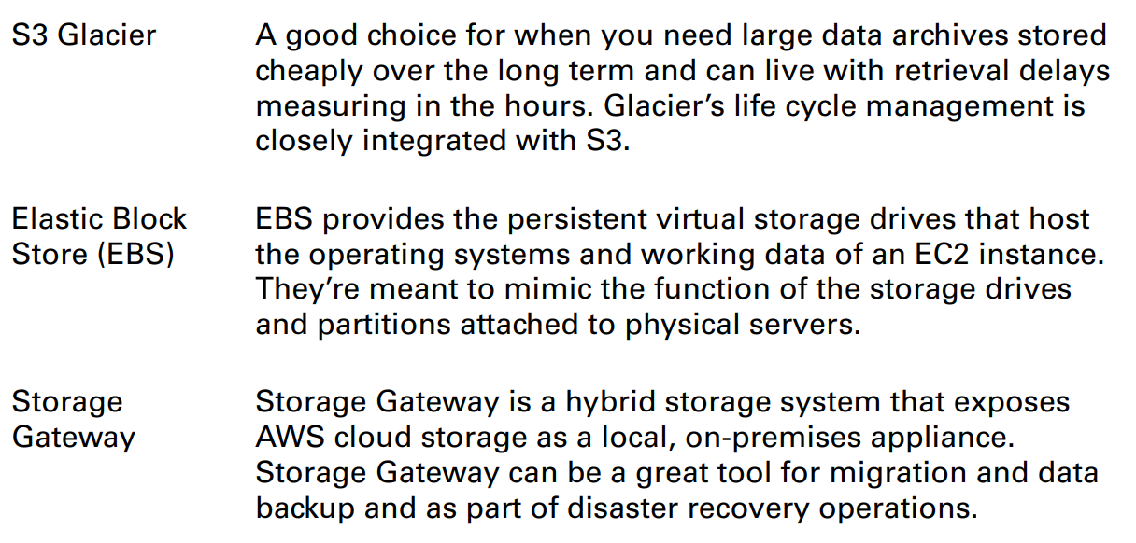
Storage

Slide 16
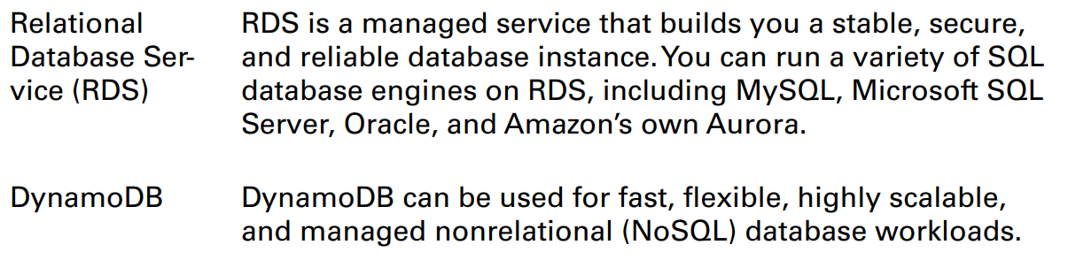
Database

Slide 17
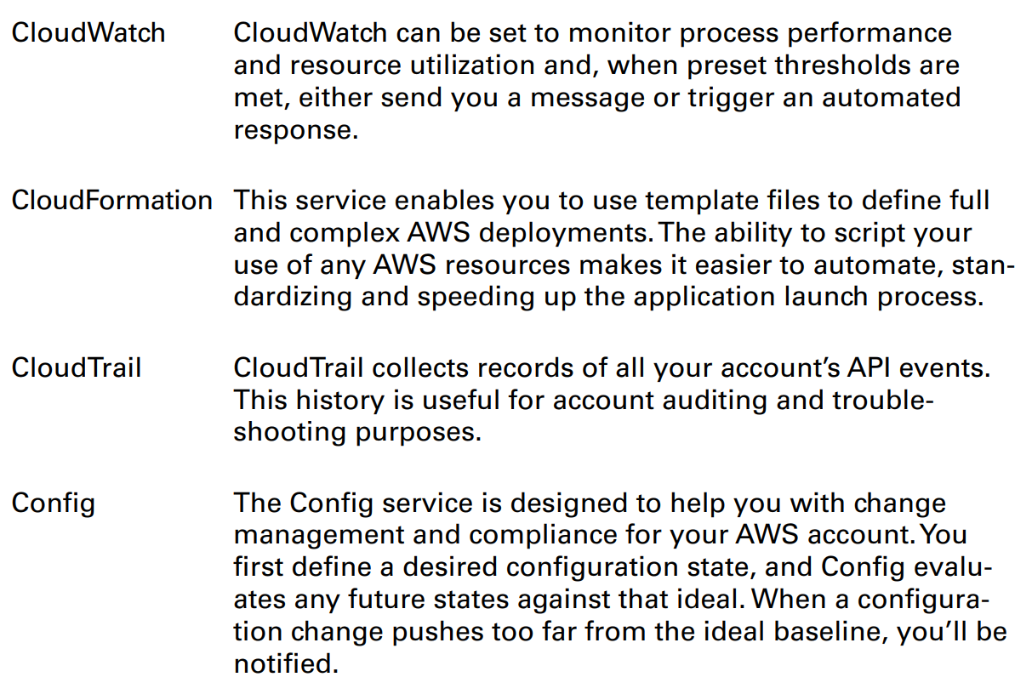
Application management

Slide 18
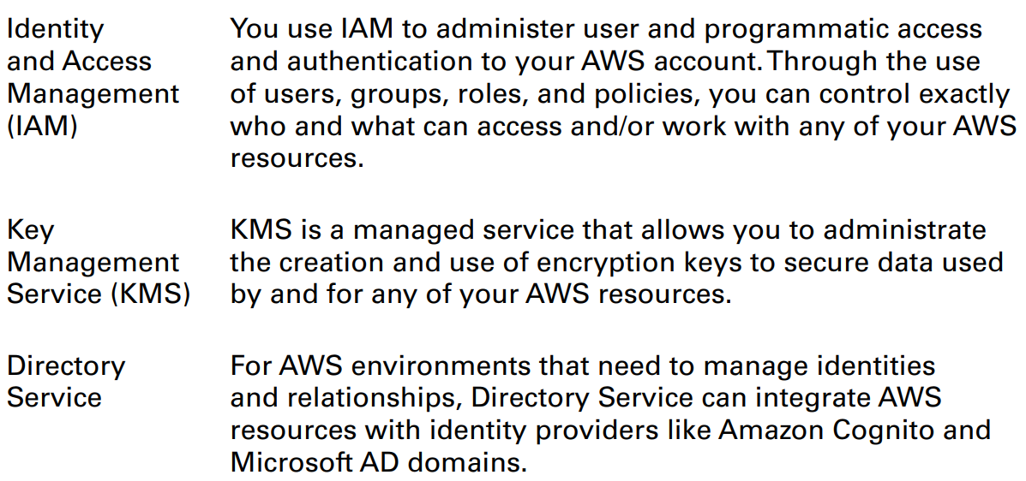
Security and identity

Slide 19
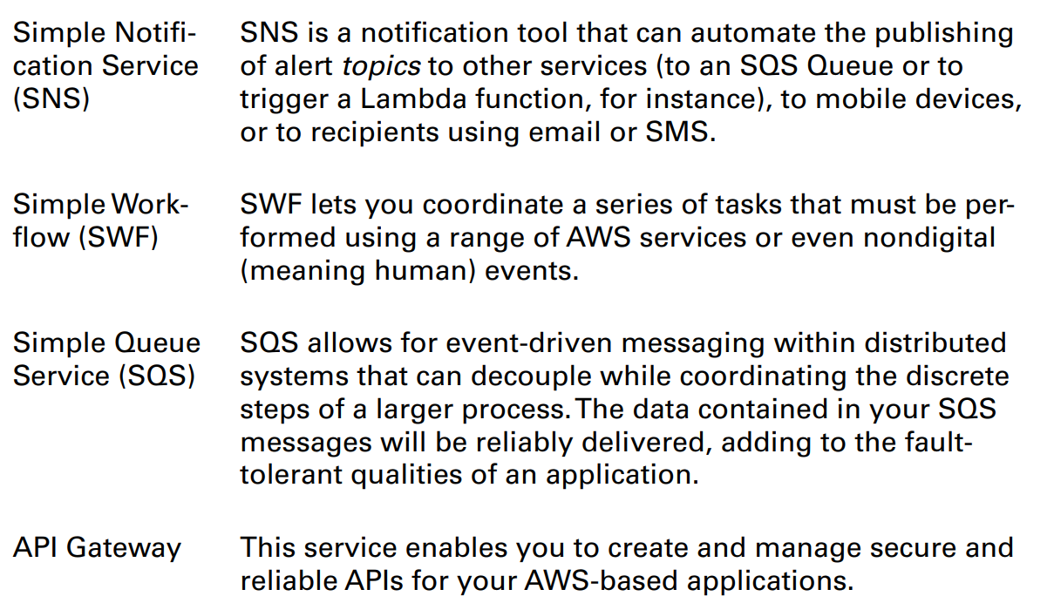
Application integration

Slide 20
References
https://mycloudwiki.com/cloud/cloud-services-and-models/
https://aws.amazon.com/about-aws/global-infrastructure/?nc1=h_ls
https://viblo.asia/p/co-so-ha-tang-toan-cau-cua-aws-Ny0VGjj8LPA

Slide 21
Next step
Service
IAM
EC2
Action
Glossary
Hand-on lab
Test
Notes:
Glossary
Document
Hand-on lab

